Slide 1
TRAN Meeting with National Parliaments Presentation by TEN-T Orient East Med Corridor Coordinator M. Grosch
Brussels EP, 13 October 2015
15:00 – 18:30 J,Antall Room 4Q2

Slide 2
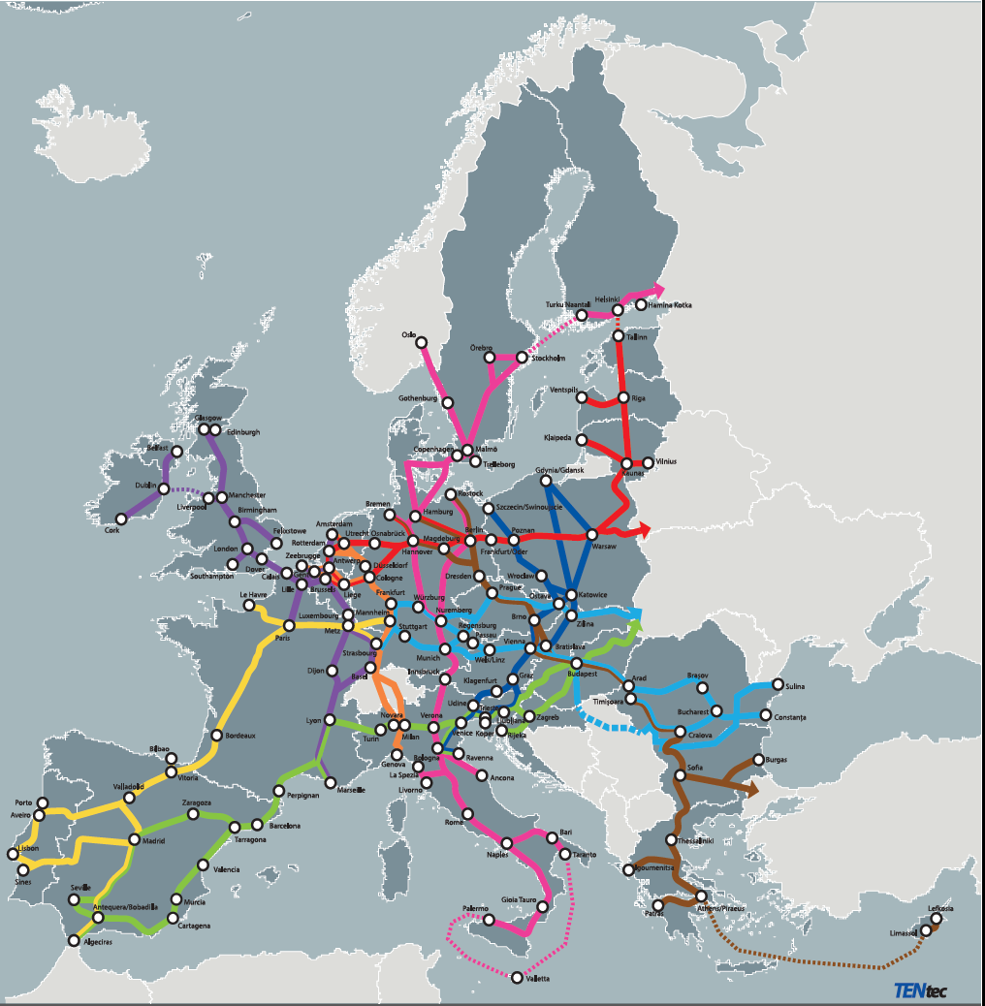
Les 9 corridors du RTE T 1)Baltic/Adriatic C (Dansk to Ravenna) 2)North Sea/Baltic C (Rotterdam to Tallinn) 3)Med C (Algeciras to UKR border) 4) OEM C (Hamburg to Cyprus) 5) Scan/Med C (Oslo/Stockholm to Malta) 6) Ralp C (Rotterdam/Antwerp to Genoa) 7)Atlantic C (Manheim-Le Havre to Lisboa/Algeciras) 8)North Sea/Med C (IRL/North UK to Marseille) 9)Rhine/Danube C (Frankfurt/Mannheim to Constanta)

Slide 3
The TEN-T Regulation: Regulation (EU) No 1315/2013
A core and a comprehensive network based on a single European methodology
Standards on the core network to be achieved by 2030
Coordinators and Core Network Corridors as implementation tools
Work Plans as road maps for developing the corridors

Slide 4
The Connecting Europe Facility: an increased budget for the TEN-T 2014-2020 (after EFSI) Regulation (EU) N°1316/2013
€24.05 bn for TEN-T Project (vs €8 bn in 2007-2013!)
€11.3 bn for Member States eligible to the Cohesion Fund, with specific rules
€12.2 bn for all 28 EU MS

Slide 5
What is the role of the TEN-T Corridor coordinators? Reg 1315/2013 Art 45-48

Slide 6
-support implementation of the CNC, and in particular the timely implementation of the work plan for that core network corridor;
-draw up the corridor work plan together with the Member States and monitor implementation;
-consult with the Corridor Forum in relation to that plan and its implementation;
-report to MS, Commission and, as appropriate, to all other entities directly involved in the development of the CNC on any difficulties encountered and, in particular when the development of a corridor is being impeded, with a view to helping to find appropriate solutions;

Slide 7
-draw up a report every year for the European Parliament, Council, Cion and MS concerned on the progress achieved in implementing the CNC;
-examine the demand for transport services, the possibilities of investment funding and financing and the steps to be taken and the conditions to be met in order to facilitate access to such funding or financing, and give appropriate recommendations.

Slide 8
Corridor process in 2014 - 2015
5 Corridor Forum meetings with gradually increasing number of stakeholders
Several specific working group meetings (Ports, Regions, urban nodes)
Several 10th of bilateral meetings and missions along corridor by European Coordinators
Corridor meeting during the TEN-T Days in Riga in June 2015: presentation of the corridor work plan to a wider audience
TEN-T Committee meetings during Forum weeks to closely involve MS and guarantee harmonised approach

Slide 9
Main outputs so far
Corridor study with detailed analysis of the corridor, including a multi-modal transport market study
TENtec maps illustrating compliance of corridor infrastructure with TEN-T standards
List of projects planned to be implemented along the corridor by 2030
A corridor work plan presented by the European Coordinator and unanimously approved by all MS in May 2015
Frauenhofer Study : economical and social impact of non completion of the corridors

Slide 10
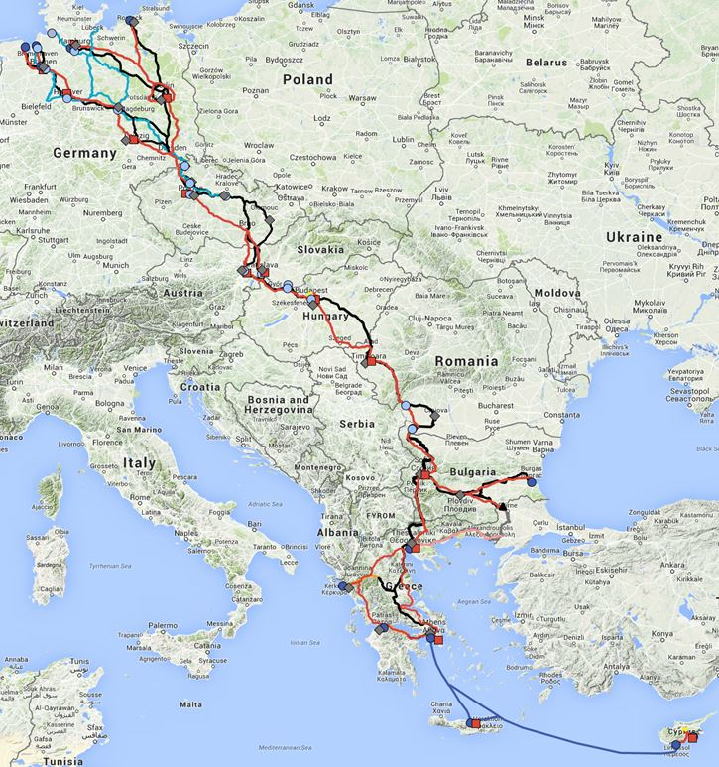
OEM Corridor characteristics 5.900 km rail, 5.600 km roads and 1.600km IWW
9 Member States
15 core urban nodes
15 core airports
10 inland ports
12 Maritime ports
25 RRT

Slide 11
Status of Rail infrastructure differences on the OEM corridor(an example..)
A train travelling from Athens (GR) to Hamburg (DE) would have to comply with the following standards:
Loc's equipped with 7 different signaling systems or change 6 times the loc!
Even if Loc equipped with 3 current capacities, 4 times to be replaced by a diesel loc!
Maximum length of train of 600m (instead of 740m), except in BU sections where max length is 445m
Max axle load of 20 T
Loc would run at max 80km/h on 510km!
INTER OPERABILITY problems!!

Slide 12
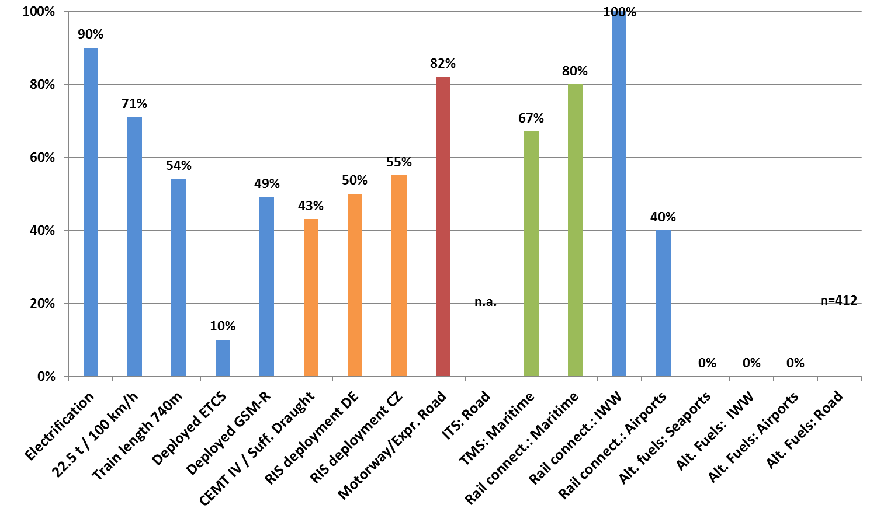
KPI Benchmark Values (2013)

Slide 13
CALL 2014: Record €13 bln investment in 276 projects with high EU added value

Slide 14
High investment needs identified
For 9 CNC: more than 2.700 projects and more than 650 billion €
For OEM only: 280 investments have been identified which would be needed for the development of the Orient East-Med Corridor by 2030
Estimated total volume of investments of around 47.4 billion EUR (at 2014 prices)
25,6 billion€ must be spent on critical issues (as far as costs are known)
Approx. 15,8 billion€ of these costs for critical issues are still to be financed
Prioritization of investments is of utmost importance and a competitive planning and financing framework needs to be set up

Slide 15
Thank you for your attention

