Slide 1
Financing of TEN-T projects via INEA
Committee on Transport and Tourism, 13 October 2015
Dirk Beckers, Executive Director, Innovation and Networks Executive Agency

Slide 2
Overview
What is an Executive Agency?
Division of tasks
Programmes of INEA
TEN-T Programme – Focus on cross-border links
CEF Transport
  Results of the 2014 Calls
  Launch of the 2015 Calls

Slide 3
What is an Executive Agency?
An Executive Agency established/supervised by the Commission
Entrusted with certain tasks relating to the management of various EU programmes, and the related Union budget lines
Own legal personality (which allows concluding of contracts)
INEA (Innovation and Networks Executive Agency) is one of six Executive Agencies
INEA is the successor of the TEN-T Executive Agency (created in 2008) – budget increase from €8 billion to €34 billion

Slide 4
Division of tasks
European Commission
defines the policy
Makes political decisions regarding the programmes
Defines strategy, objectives and priority areas of action
Supervises the Agency
INEA
makes implementation happen
Turns policy into action by implementing programmes on behalf of the EC and under its responsibility
Manages entire project lifecycle
Communicates and interacts with beneficiaries
Increases visibility of EU funding
Gives key feedback to the EC

Slide 5




INEA's programmes
Legacy Programmes (2007–2013)
New Multi-annual Financial Framework (2014–2020)

Slide 6
INEA's programmes
Legacy Programme (2007–2013)
New Multi-annual Financial Framework (2014–2020)
Focus for today

Slide 7
TEN-T legacy
(2007-2013 period)
Total Programme budget managed by INEA: €7.4 billion
Total 2007-2013 TEN-T project portfolio
699 selected, 385 ongoing
53% of the budget allocated to 203 cross-border projects
Successful re-injection of unused funds (2011) in the light of Mid-Term review (2010)
→ use-it-or-lose-it principle
Total investments through TEN-T projects as of today is
€34 billion (leverage effect of almost 5x)

Slide 8
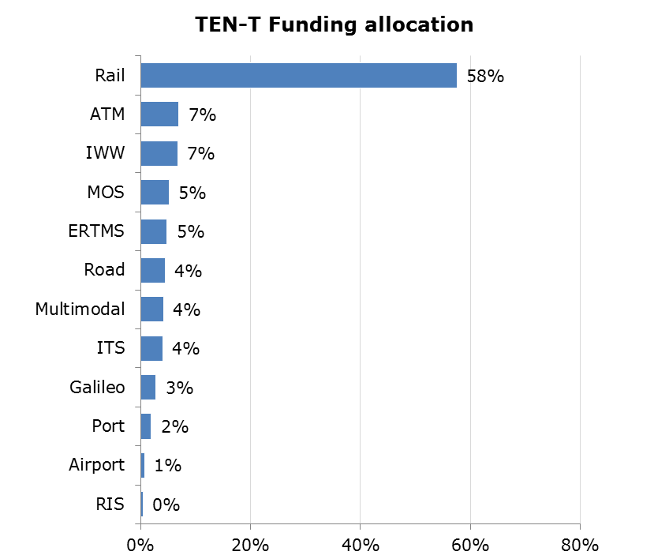
TEN-T legacy: Support to environmentally friendly modes of transport

Slide 9
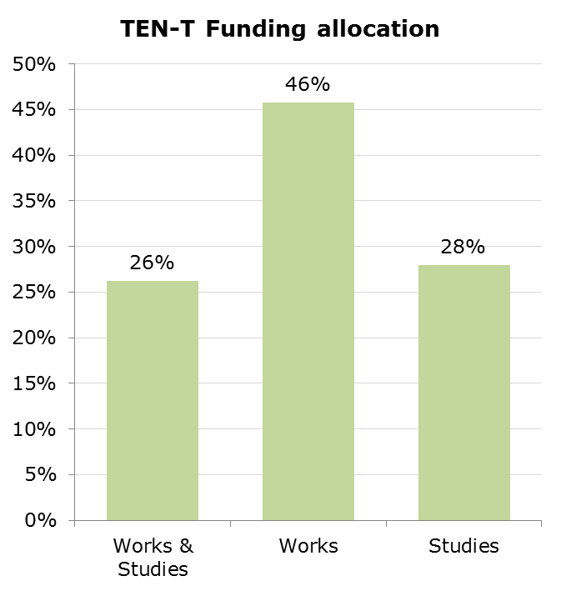
TEN-T legacy: Studies vs Works
354 studies are supported from the TEN-T Programme (more than 50% of all projects)
Source: INEA data

Slide 10
CEF Transport priorities
Major cross-border projects and projects addressing main bottlenecks on the 9 multimodal Core Network Corridors
Implementation of the horizontal priorities (e.g. ERTMS, ITS, SESAR,…)
New technologies and innovation
Increased opportunity for private investment support
Connect TEN-T network with neighbouring countries
Total initial budget (2014-2020): €26.2 billion, of which
  €2.2 billion for EFSI
  €1.5 billion for CEF Debt Instrument
  €22.5 billion for grants to be managed by INEA (of which €11.3 billion from Cohesion Fund)

Slide 11
CEF Transport Funding Objectives
Removing bottlenecks and bridging missing links (~80% of max budget)
Ensuring sustainable and efficient transport in the long run (~5% of max budget)
Optimising integration and interconnection of modes and enhancing interoperability (~15% of max budget)
FO1
FO2
FO3
General envelope
Cohesion envelope

Slide 12
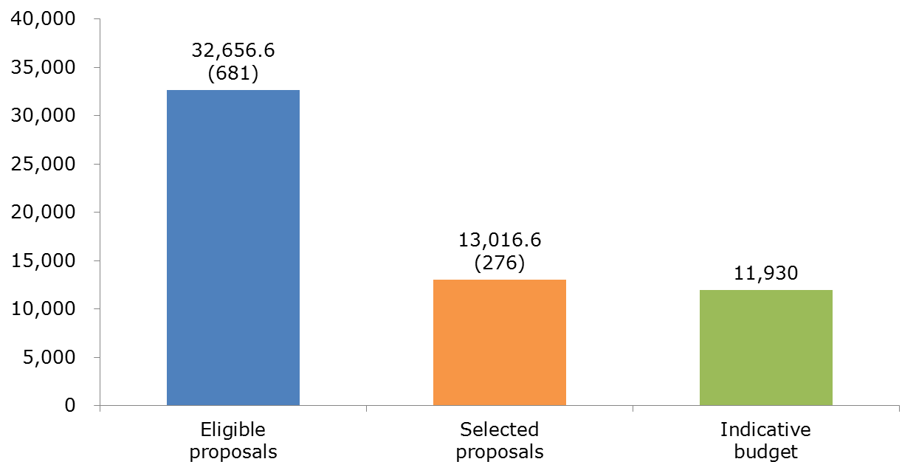
Result of the 2014 CEF Transport Call
Requested funding 3 x more than available budget
Total costs of selected proposals €28.8 billion
Leverage of more than 2 times

Slide 13
Result of the 2014 CEF Transport Call
Focus on implementation of projects: 59% to works and 34% to mixed projects with only 7% to studies
Bridging missing links and removing bottlenecks: €12 billion of CEF Transport funding allocated
New focus on Innovation: €157 million to 26 projects
Integration and interconnection of modes: €375 million to SESAR, €259 million to Motorways of the Sea, €75 million to ITS, €47 million to Urban Nodes, €30 million to multimodal platforms and €11 million to River Information Services
Promote green transport: More than 93% of the budget allocated to rail, Inland Waterways, maritime and SESAR

Slide 14
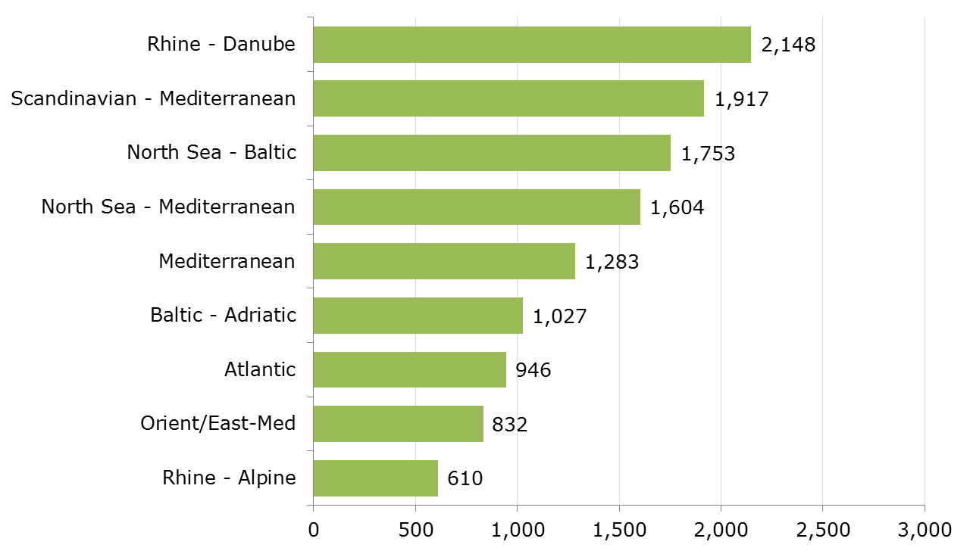
A strong focus on Core Network Corridors
(93% of the allocated funding, in € million)

Slide 15
2015 CEF Transport calls
Two Calls for Proposals will be launched shortly:
  General envelope (€1.1 billion) including:
    Innovation
    Traffic Management Systems
    Urban nodes
    Motorways of the Sea
  Cohesion envelope (€6.5 billion) including:
    Same as general envelope
    Additionally, bridging missing links and removing bottlenecks on the Core Network Corridors (€5 billion)
Indicative timetable
Publication of Calls | early November 2015
Call Closure | 16 February 2016
Information to applicants | July 2016

Slide 16




For more information
inea@ec.europa.eu
http://ec.europa.eu/inea
@inea_eu
Look for INEA!

